Slide 1
CertifAI: Automated Certificate Data Extraction
Group Members:
Govindula Srinith(211010226)
Rapolu Shiva Teja(211020435)
Kadali Umesh Chandra(211020423)
Supervisor name:
Dr. Mallikharjuna Rao
Date:17-05-2024
International Institute of Information Technology, Naya Raipur

Slide 2


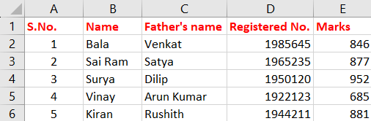
Problem Definition/Problem statement
Extract the information from the pdf documents from certificates and present them in a structured way
International Institute of Information Technology, Naya Raipur

Slide 3
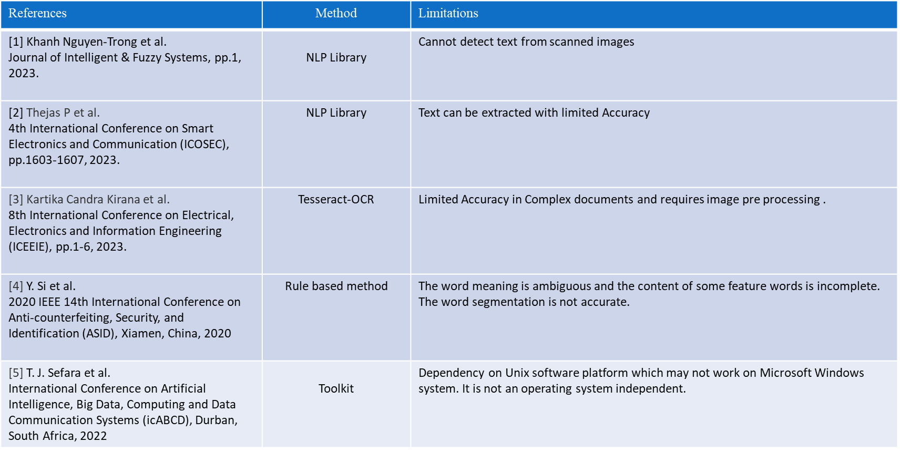
Literature Review
International Institute of Information Technology, Naya Raipur

Slide 4

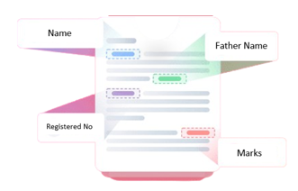



Proposed Framework/Methodology

Slide 5
Demonstration
Video
International Institute of Information Technology, Naya Raipur

Slide 6
Future Scope
Create a user interface
2. Multilingual Support
3. Finetuning the LLM
4. Enhanced security measures
International Institute of Information Technology, Naya Raipur

Slide 7

Thank You
..
Dr. Shyama Prasad Mukherjee International Institute of Information Technology, Naya Raipur
International Institute of Information Technology, Naya Raipur

